Slide 1
Silicon Valley as Global Leader in Technology Innovation
Barry D. Wood
American Center, Prague
November 1, 2017

Slide 2
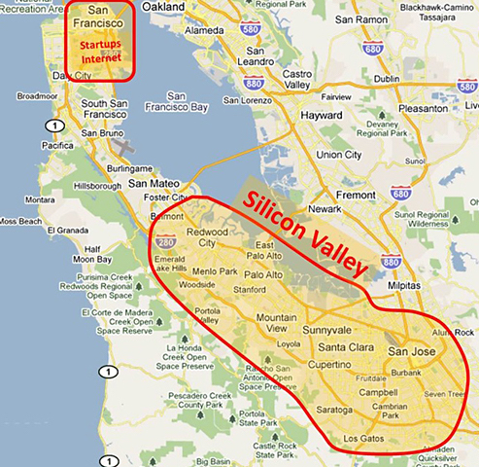

Slide 3
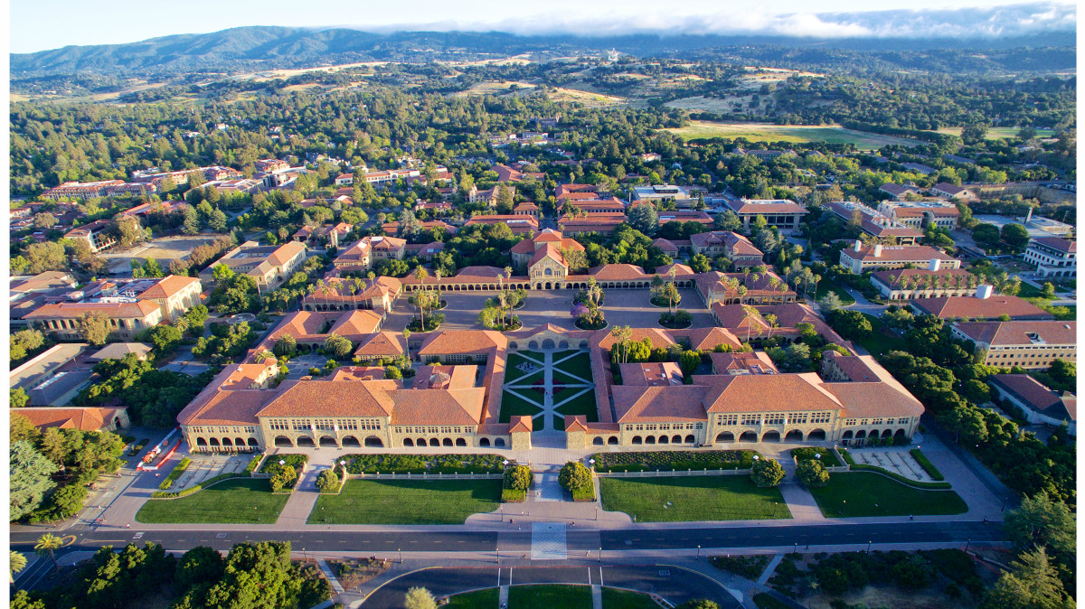
Stanford University, Palo Alto

Slide 4
Key Events:
Stanford Engineering School
Defense and Space Industry
Hewlett-Packard, 1939
Transistor, Silicon Chip
Intel, 1968, Silicon Valley term first used 1971
Internet, Venture Capital
Apple Computer, 1976

Slide 5
Today’s Silicon Valley:
250,000 Tech professionals, HQs for 39 tech companies
Google—79% of search globally, 57,000 employees
Facebook- 2 billion global users, 18,000 employees
Apple—largest tech company, iPhone as disruptor
Tesla—Elon Musk the new Steve Jobs?

Slide 6
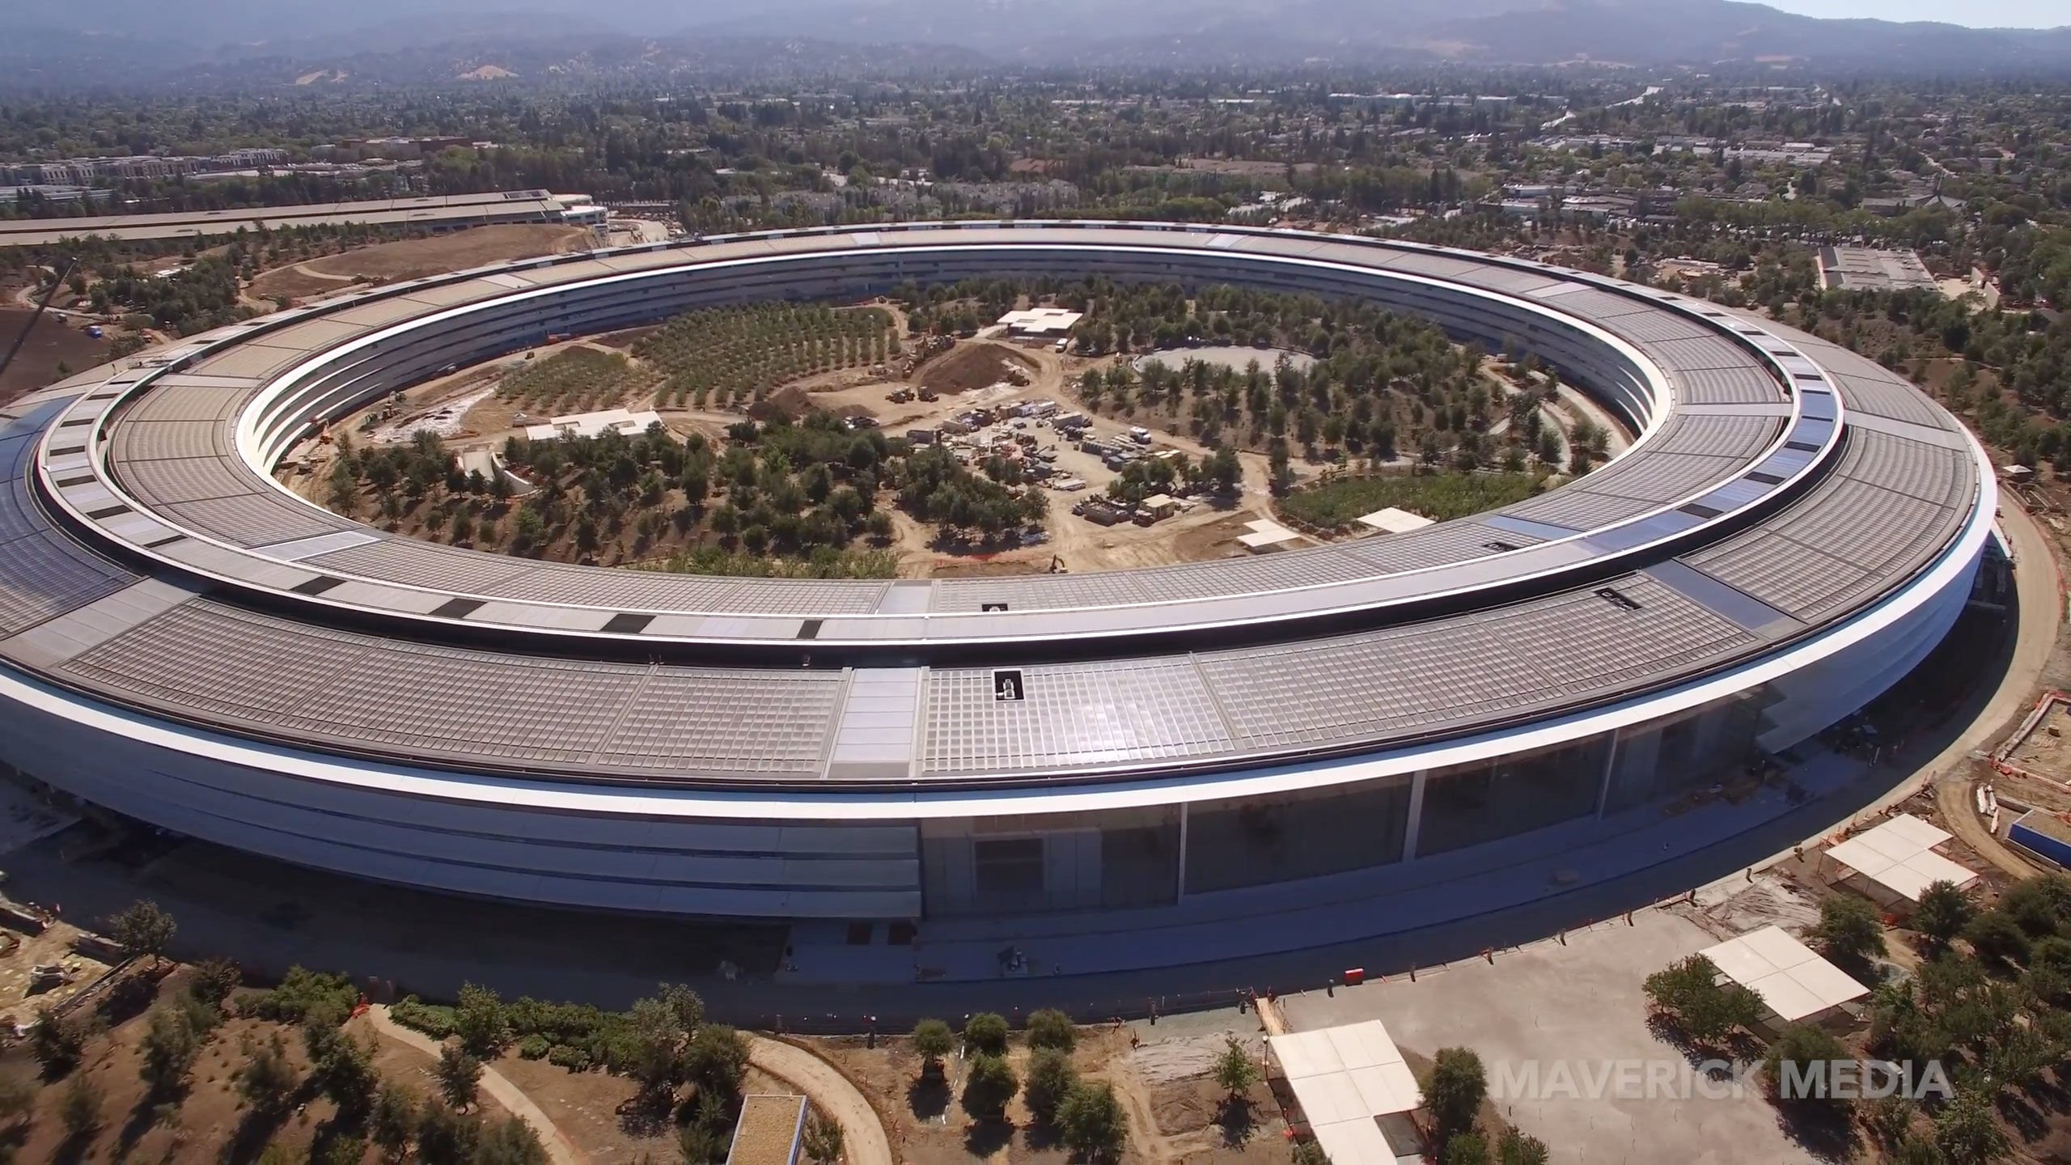
Apple Park, 2017

Slide 7
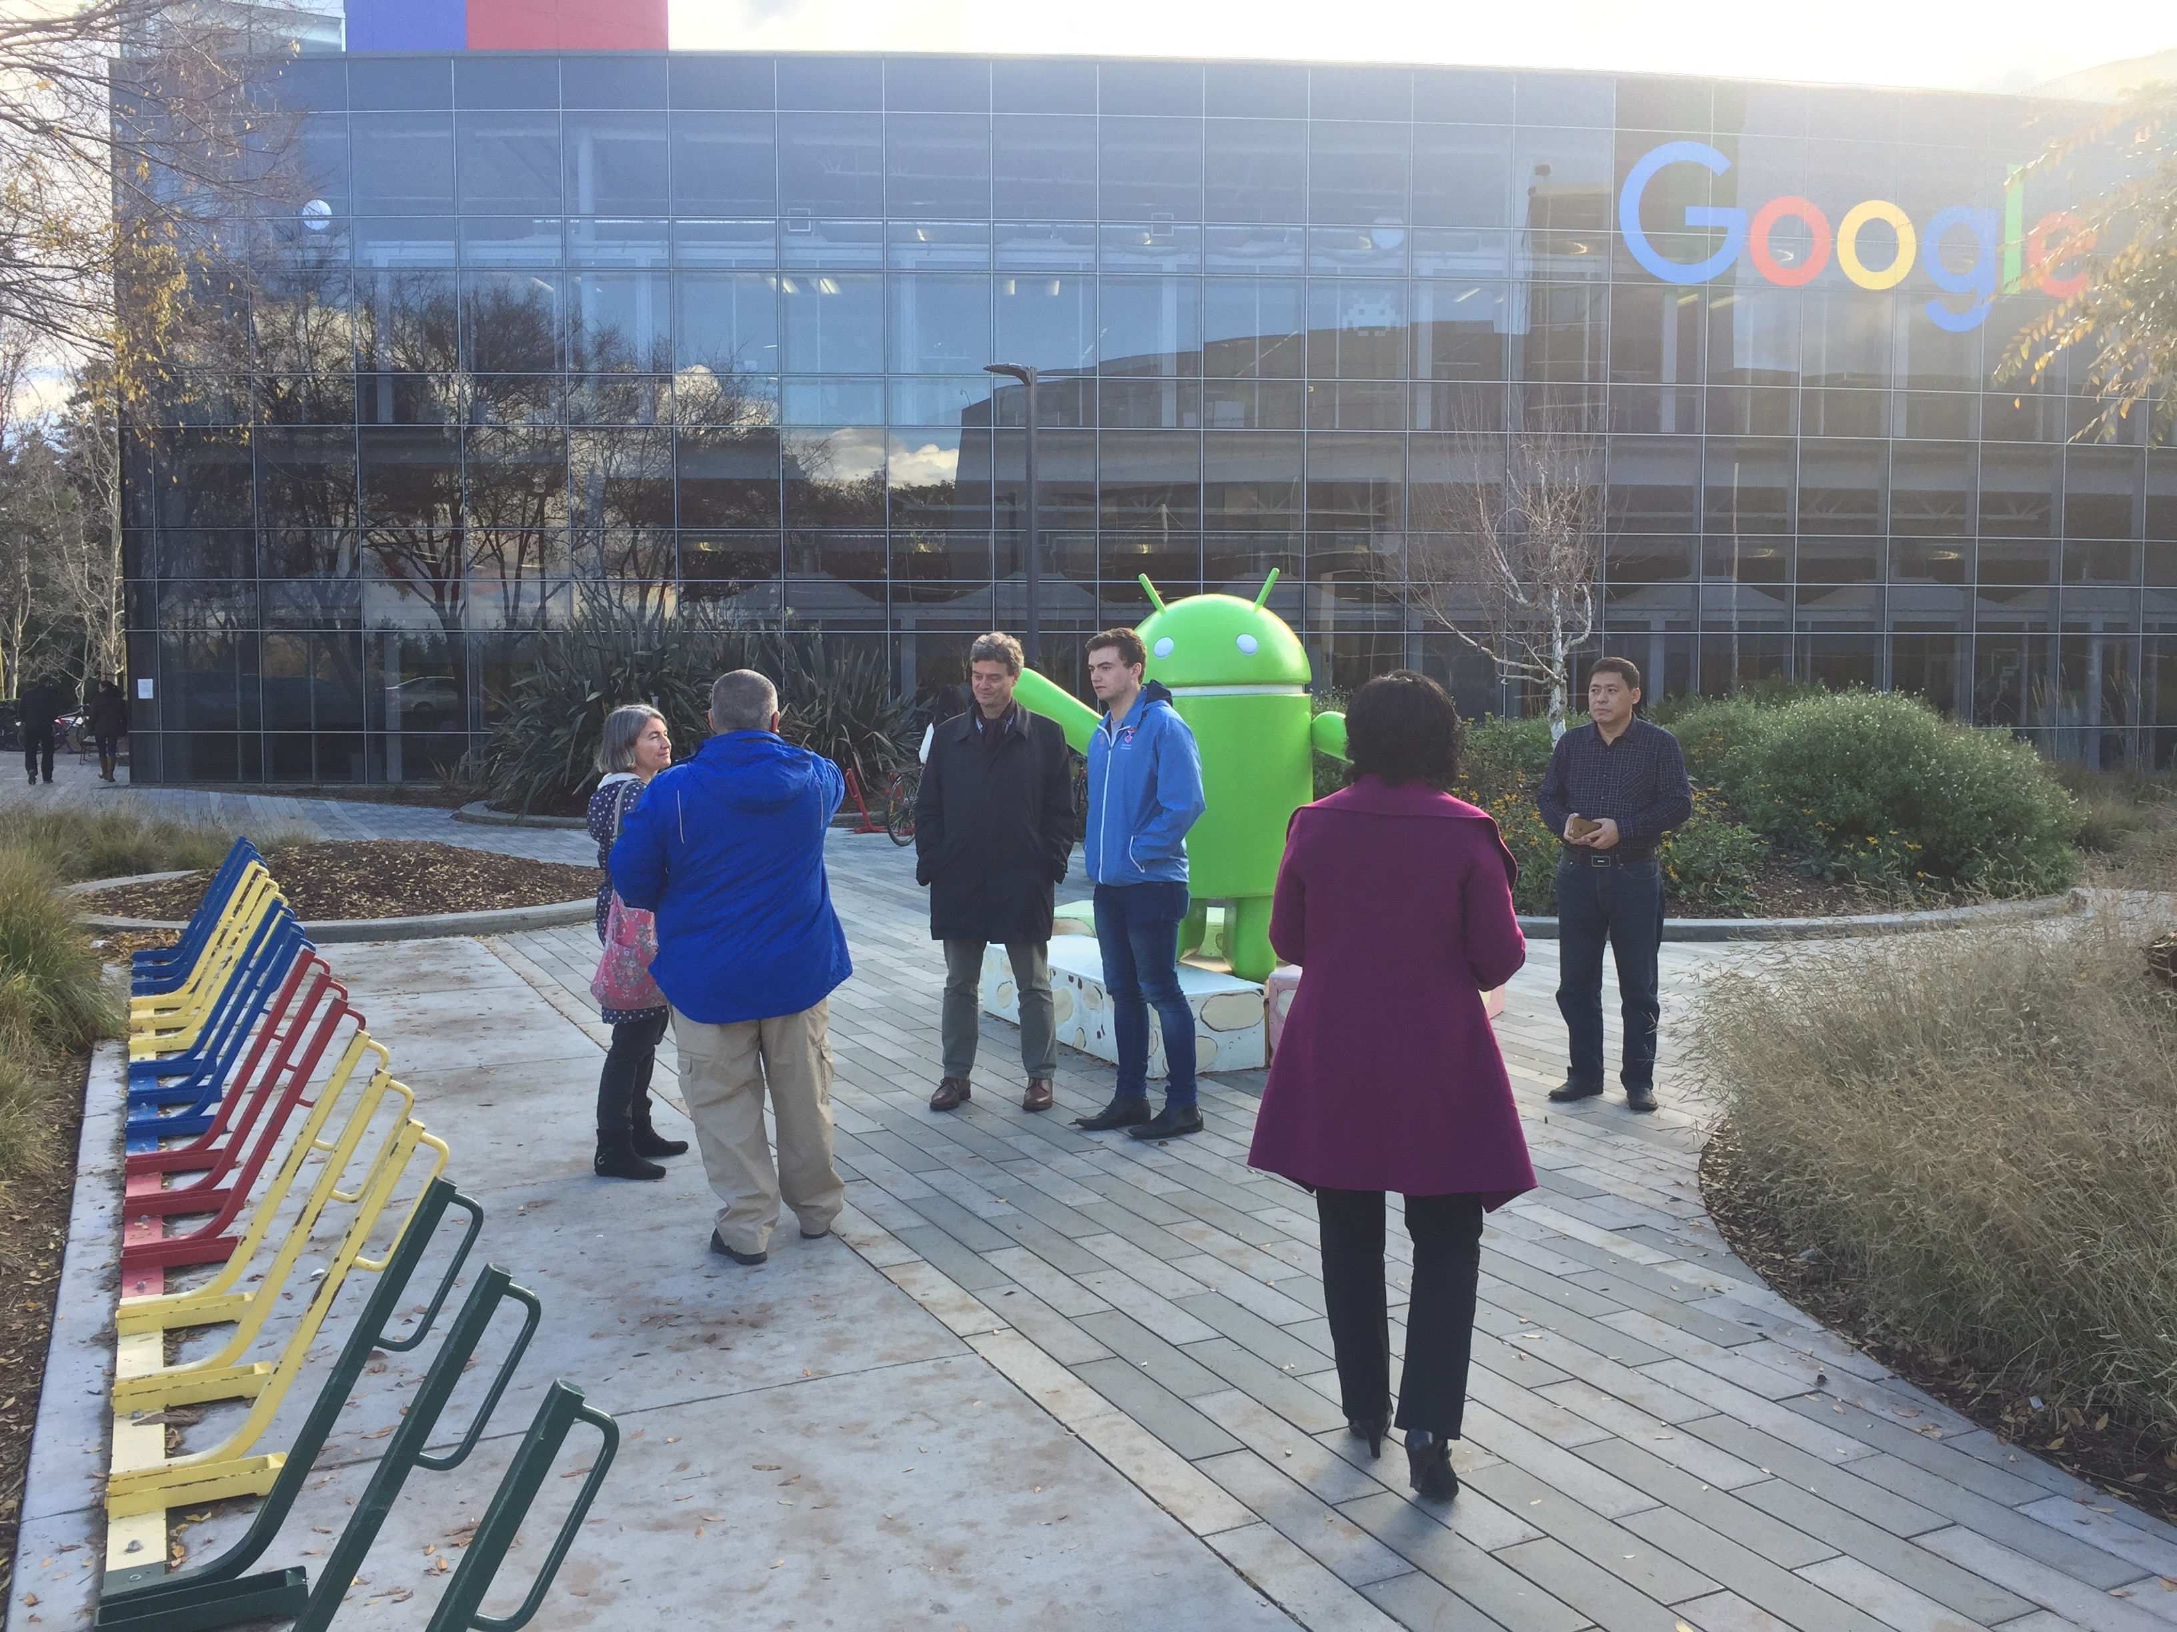

Slide 8
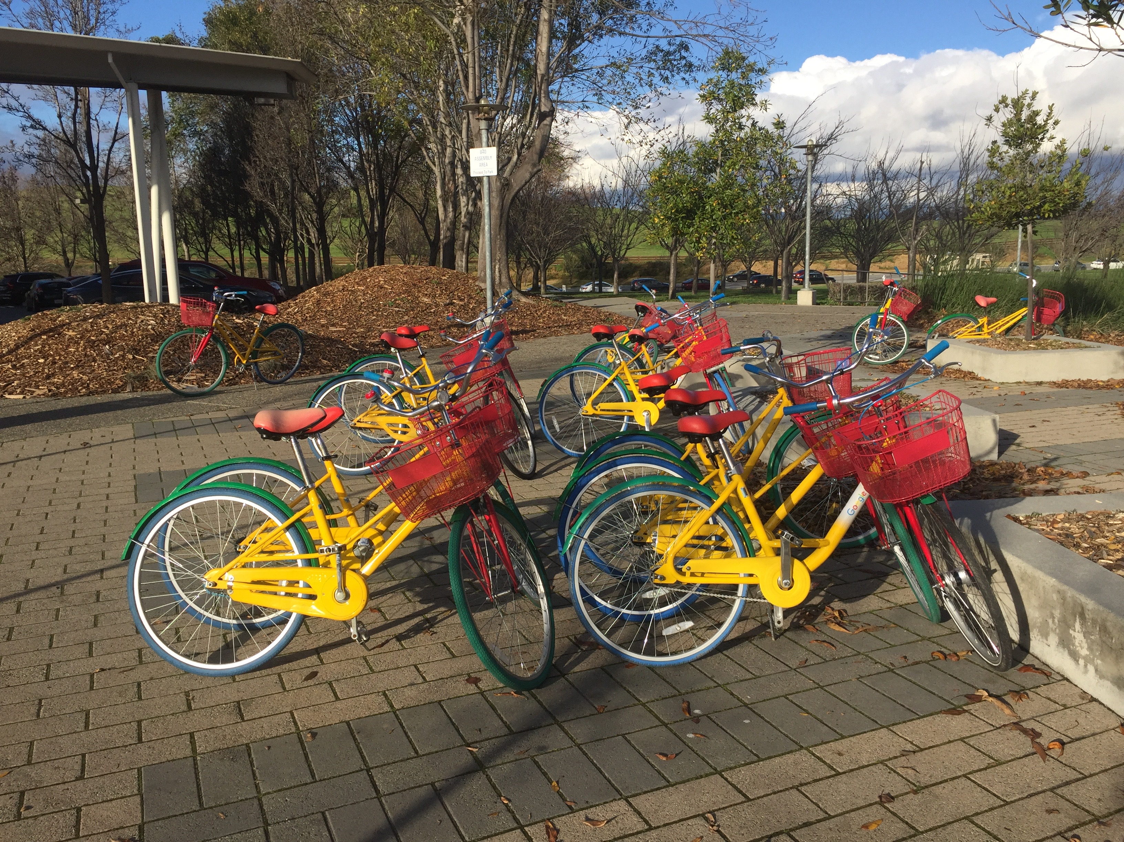

Slide 9
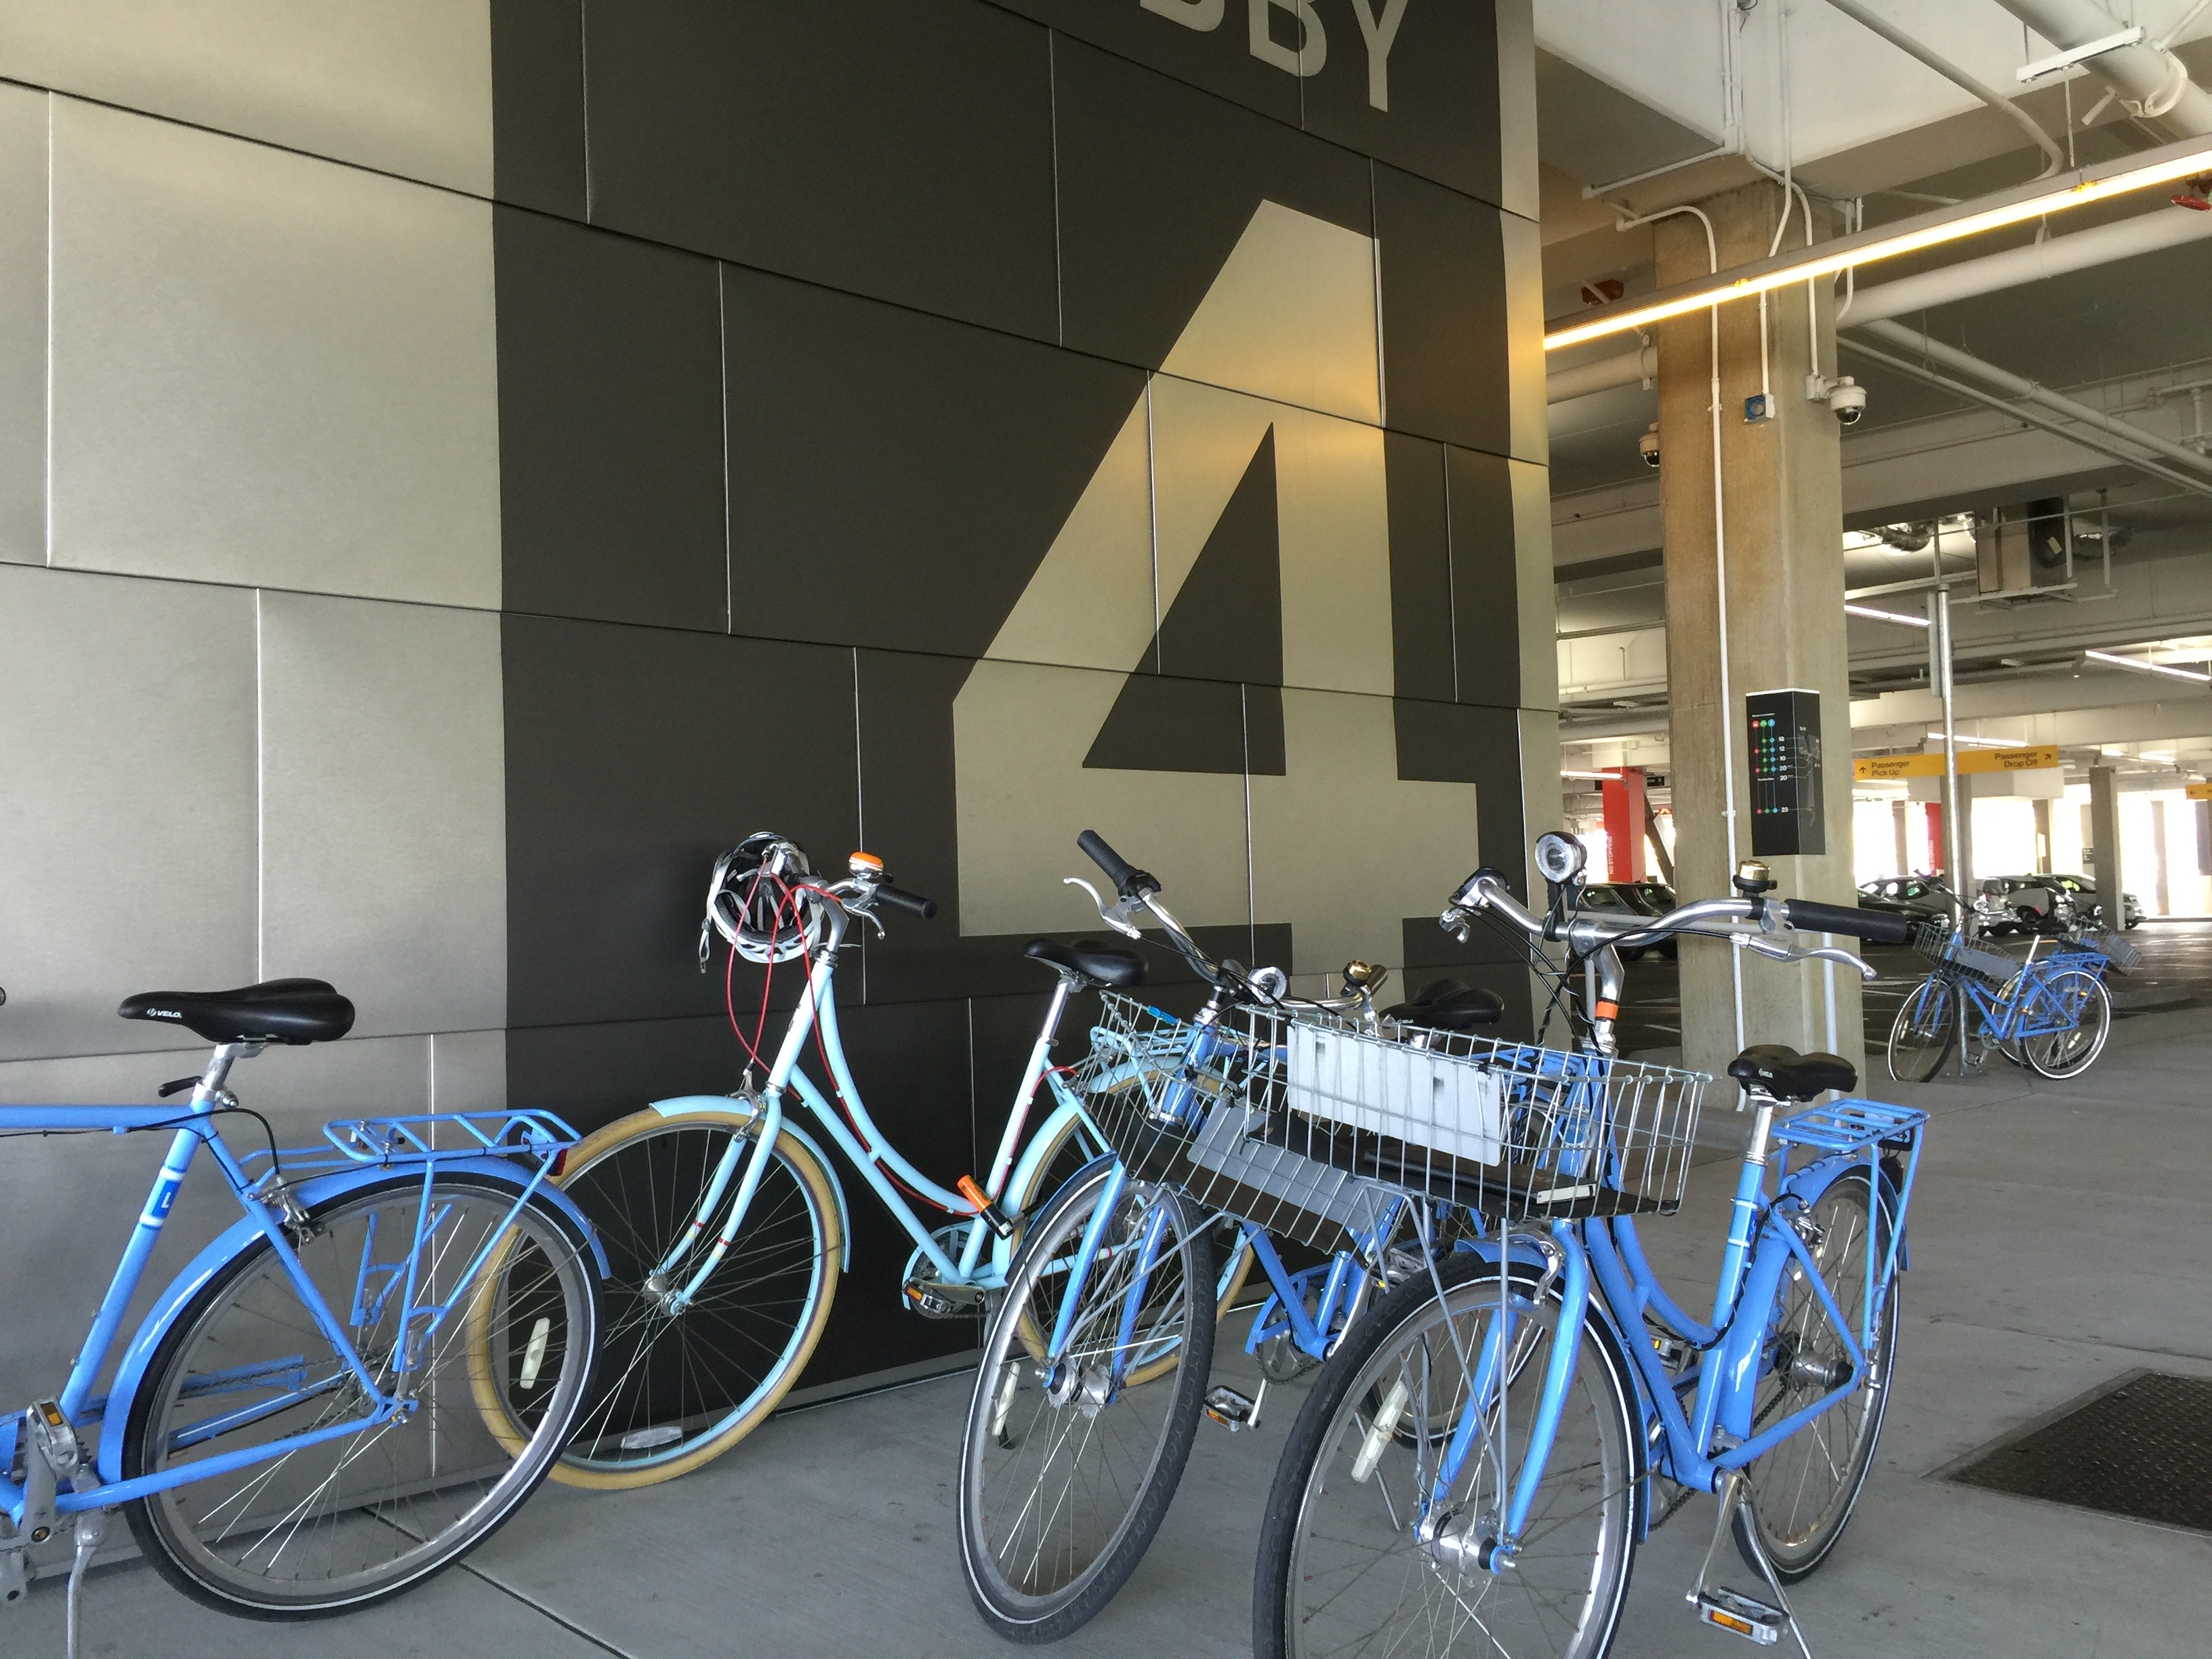

Slide 10
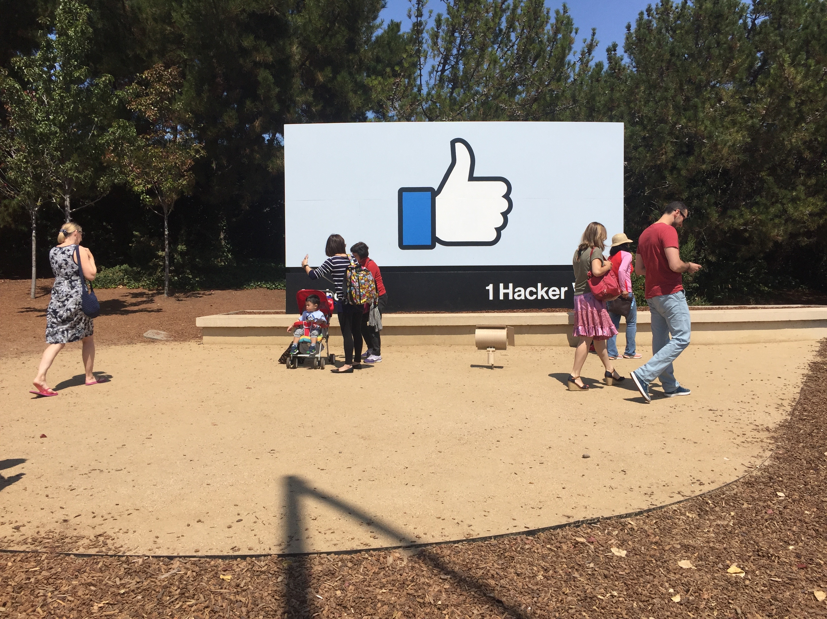

Slide 11
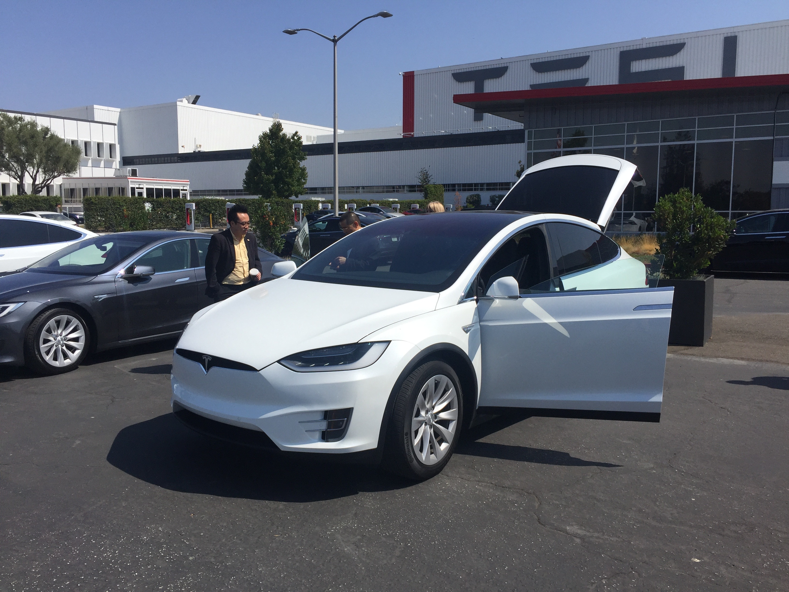

Slide 12
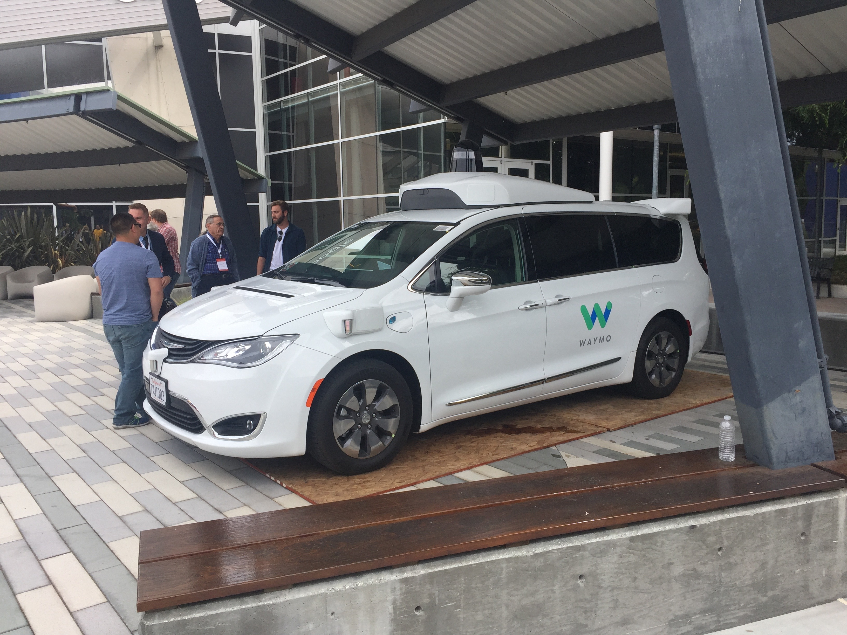

Slide 13
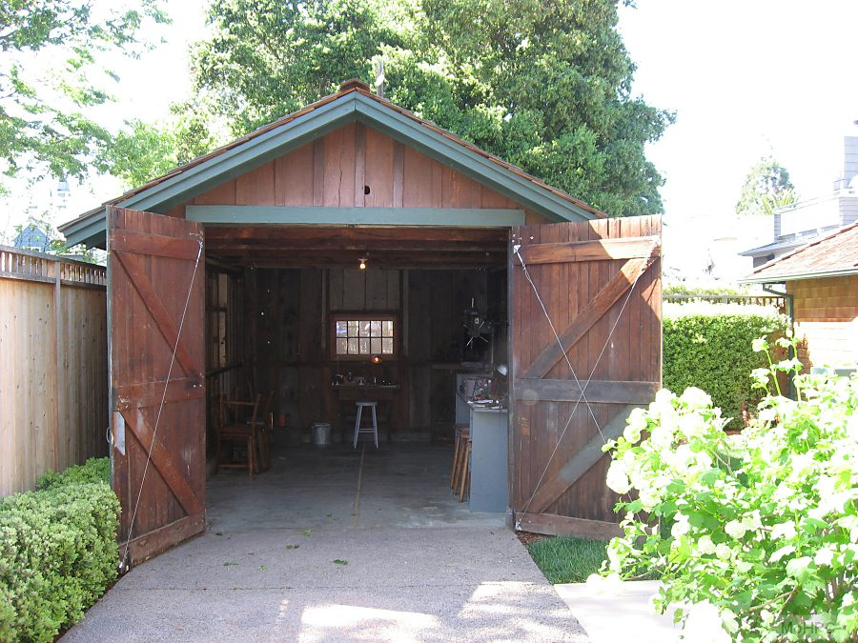
Hewlett-Packard, H-P, founded in 1939

Slide 14
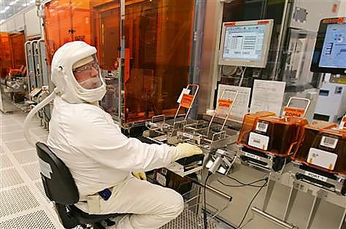
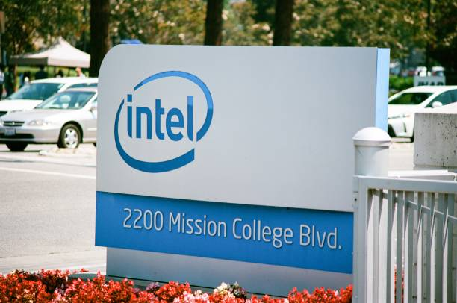
Intel, Santa Clara, 1968

