Slide 1
What’s the End Game in Hong Kong?
Barry D. Wood
For Professor Bob Guttman
Johns Hopkins University
October 28, 2019

Slide 2
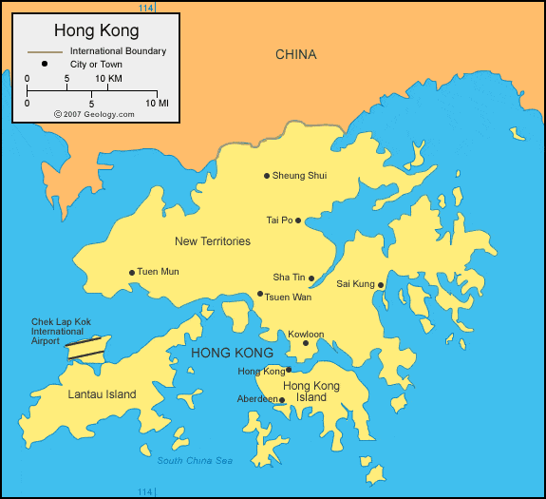

Slide 3
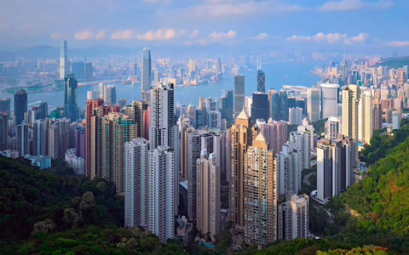

Slide 4
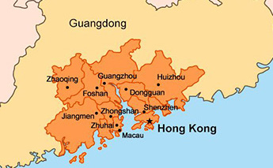

Slide 5
Hong Kong Strengths Making it #1 on Economic Freedom Index:
Asia’s Financial Hub
Rule of Law, independent judiciary
Convertible Currency
Services-- lawyers, accountants
Low taxes
Free speech, independent media

Slide 6
Hong Kong’s Weaknesses:
World’s most expensive city
Shortage of housing, median flat price equal to 21 times income
Being subsumed into Greater Bay Area
Shortage of start-ups and entrepreneurship

Slide 7
Five Demands of Protesters:
Withdrawal of extradition measure
Commission of Enquiry into Police Conduct
Amnesty for those arrested
Protests not to be identified as riots
Universal Suffrage

